Slide 1
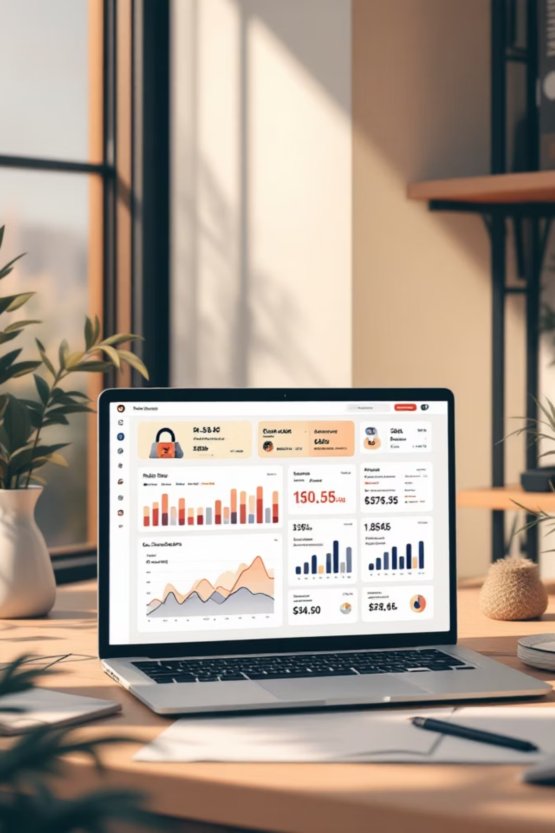
Customer Shopping Behavior Analysis
3,900 purchases. Goal: spending patterns, segments, preferences, subscriptions. Guide strategy.

Slide 2

Dataset Summary
Size
Features
Missing
3,900 rows, 18 columns
Demographics, purchase details, behavior
37 Review Rating values

Slide 3

EDA in Python
01
Load & Explore
pandas, df.info(), describe()
02
Clean & Impute
Median rating by category
03
Standardize
snake_case columns
04
Engineer
age_group, purchase_frequency_days
05
Validate
Dropped redundant promo_code_used
Loaded to SQL Server for SQL analysis.

Slide 4



Technology Stack & Workflow
Our robust technology stack ensures efficient data processing, secure storage, and insightful visualization, powering a comprehensive analytics pipeline.
Python for Data Engineering
SQL Server Data Warehouse
Power BI for Visualization
Interactive dashboards and business intelligence reports for actionable insights.
Initial data exploration, cleaning, and feature engineering for raw datasets.
Centralized data storage, enabling complex analytical queries and robust data management.

Slide 5
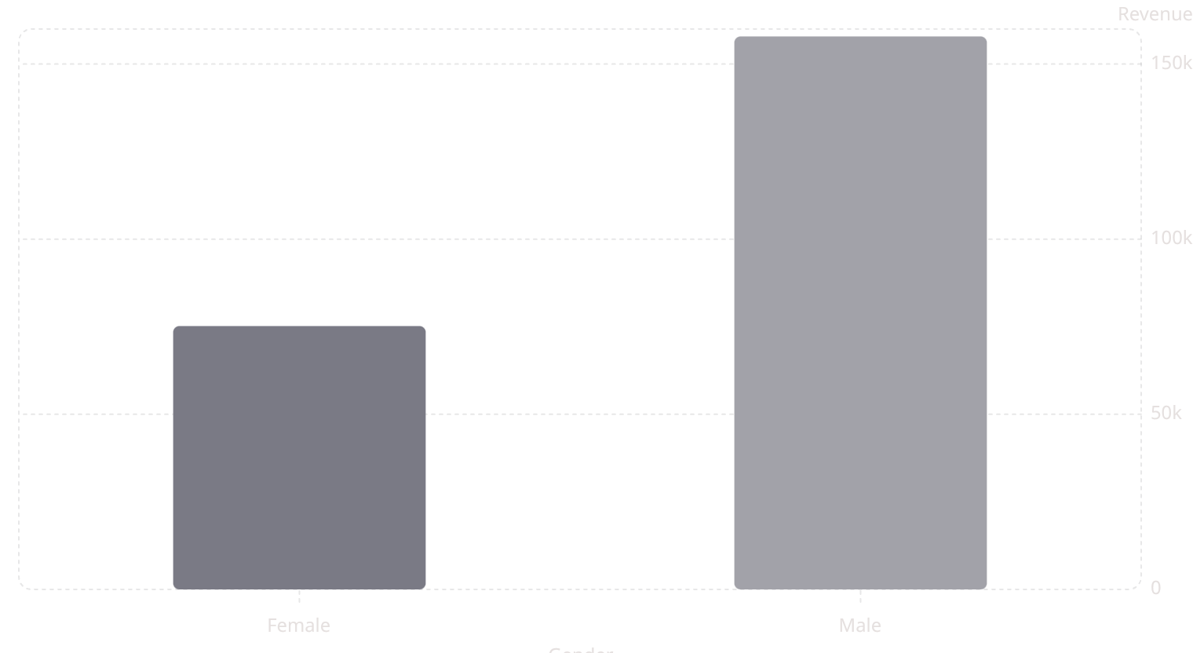
SQL Insights: Revenue by Gender
Male: 157,890
Female: 75,191
Gap highlights targeting opportunity.

Slide 6
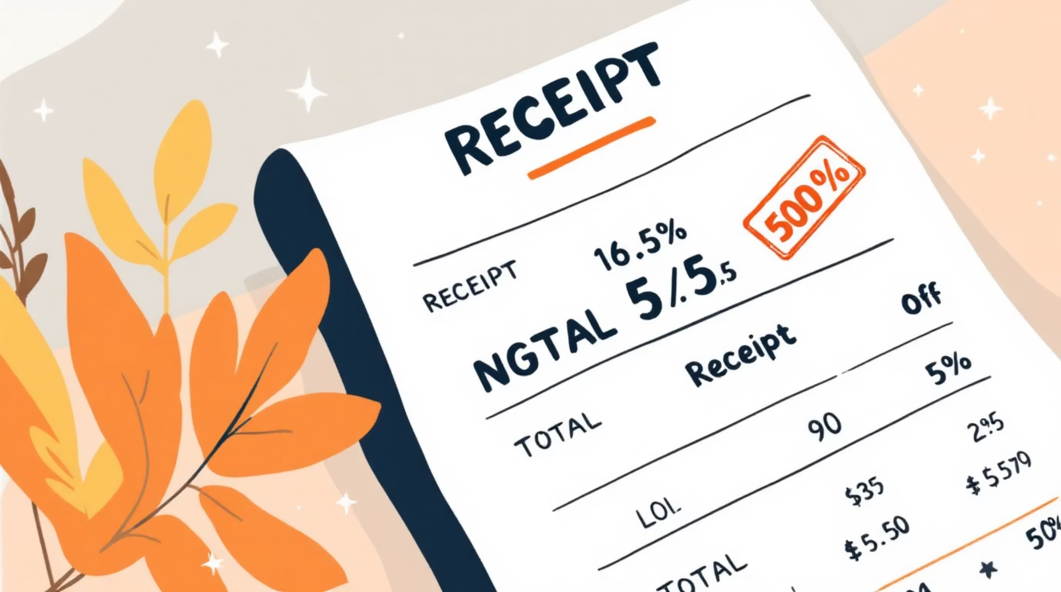
High-Spending Discount Users
Criteria
Discount applied AND above-average spend
Result
839 rows returned
Value buyers still spend big.

Slide 7


Products: Ratings & Discounts
Top Ratings
Discount-Dependent
Gloves 3.86, Sandals 3.84, Boots 3.82, Hat 3.80, Skirt 3.78
Hat 50%, Sneakers 49.66%, Coat 49.07%, Sweater 48.17%, Pants 47.37%
Position high-rated; monitor margin on discount-heavy items.

Slide 8
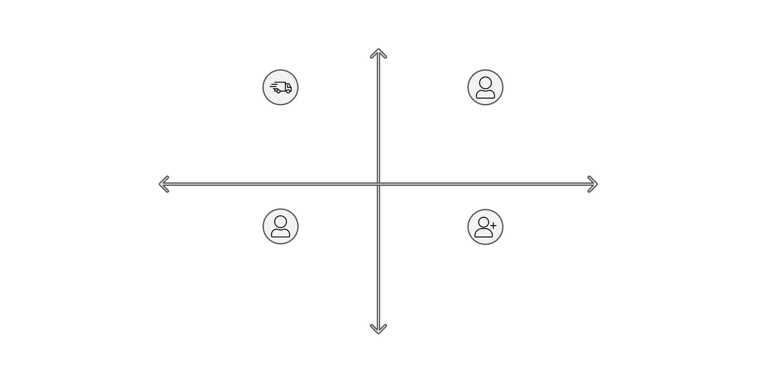

Shipping, Subscription, Segments
High Avg Spend
Shipping
Express 60.48 > Standard 58.46
High Value & Low Effort: Express & Loyal
High Value & High Effort: Subscribers
Subscriptions
Low Revenue / Effort
High Revenue / Effort
Yes 62,645 revenue; No 170,436
Low Value & High Effort: Non-Subscribers
Low Value & Low Effort: New Shoppers
Segments
Loyal 3,116; New 83; Returning 701
Low Avg Spend
Express and Loyal drive value.

Slide 9

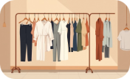
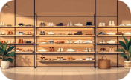
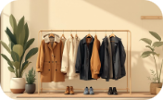
Top 3 Products per Category
Accessories
Clothing
Footwear
Outerwear
Jewelry 171, Sunglasses 161, Belt 161
Blouse 171, Pants 171, Shirt 169
Sandals 160, Shoes 150, Sneakers 145
Jacket 163, Coat 161

Slide 10
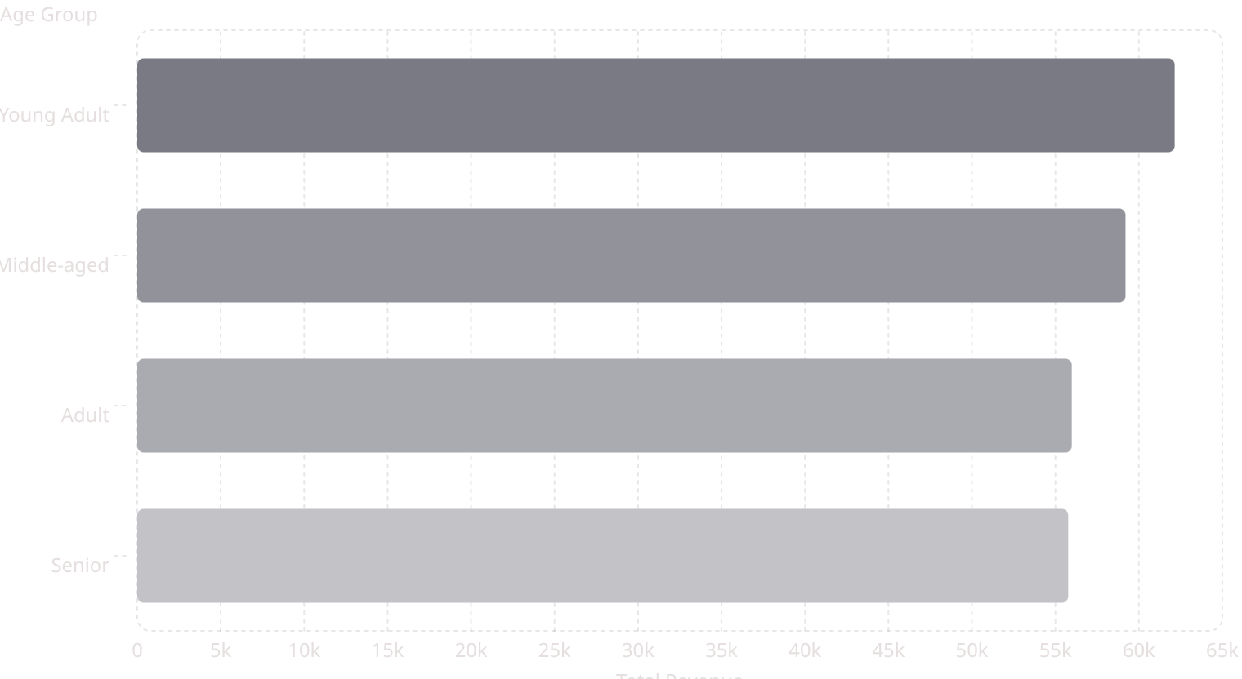
Age & Repeat Buyers
Repeat & Subscriptions
Implication
Upsell high-revenue age groups to subscribe
No: 2,518; Yes: 958

Slide 11
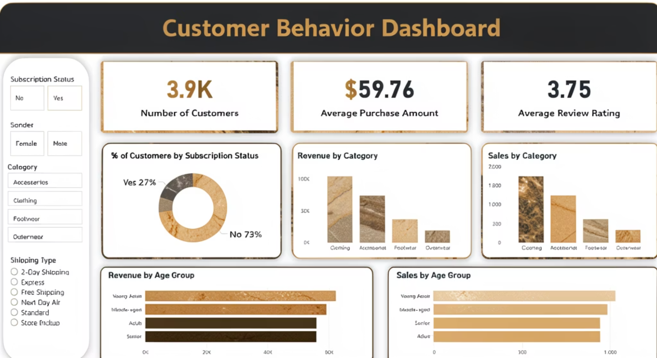
Dashboard & Recommendations
Boost Subscriptions
Promote exclusive benefits
Loyalty Programs
Move buyers to "Loyal"
Discount Policy
Balance sales and margin
Product Positioning
Highlight top-rated, best-sellers
Targeted Marketing
High-revenue ages, express users

